Slide 1
Why appsec tools suck
TOORCAMP 2009

Slide 2

My story
Andre Gironda
Interest in appsec tools
Write for tssci-security.com
Involved with OWASP

Slide 3
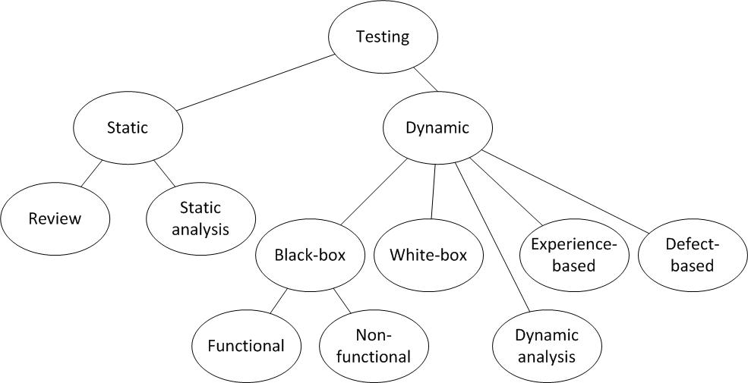
How I view appsec
Notes:
From the ISTQB

Slide 4
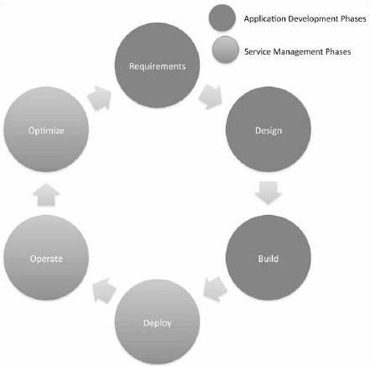
Operators = Narcissists
Operators have no idea about anything related to application development.
80%+ of vulnerability problems occur in the first three dark phases.
If operators never work with developers, their jobs will grow in difficulty.
You can only optimize so much before you have to fix problems at the root of their cause.
Notes:
Tangible ROI through secure software engineering (SooHoo, Jacquith, Sadbury)
Findings indicate that significant cost savings and other advantages are achieved when security analysis and secure engineering practices are introduced early in the development cycle. The return on investment ranges from 12 percent to 21 percent, with the highest rate of return occurring when analysis is performed during application design.
Since nearly three-quarters of security-related defects are design issues that could be resolved inexpensively during the early stages, a significant opportunity for cost savings exists when secure software engineering principles are applied during design.
Web Scanners
Fuzzers
Fault-Monitors
Debuggers
Static Analysis in-IDE / at Build-Time
Consistency Problem – Tools find Different Things

Slide 5
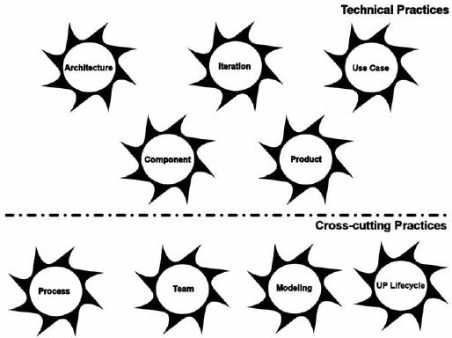
Developers = Bipolar Bears
There is no unified process. There is only Zuul
Agile and CMM mean something different to everyone. Just ask.
Dev shops rarely follow e.g. Waterfall or SCRUM exactly as written.
This diagram is EssUP from Ivar Jacobson. It uses an unpopular but relevant programming concept, AOP, and applies it to process.
Notes:
AppSec Maturity Linked to Quality Maturity
Open SAMM Linked to CMMI
Some Quality Techniques don’t apply to Security
Microsoft Visual Studio Team Editions add Process Templates
e.g. MSF Agile, xP, SCRUM (eSCRUM, SCRUM Lite), SDL Process Template
Prototyping historically allows the best bang-for-buck for developers
They timebox or run a “sprint” over the course of a few weeks. At the end of each cycle, a demonstration is provided. The demonstration is something the customer and owners can see, feel, and give feedback about. If you are interested in seeing how Prototyping or Iterative Development reduces defects compared to other tools/methods, see McConnell 740.

Slide 6
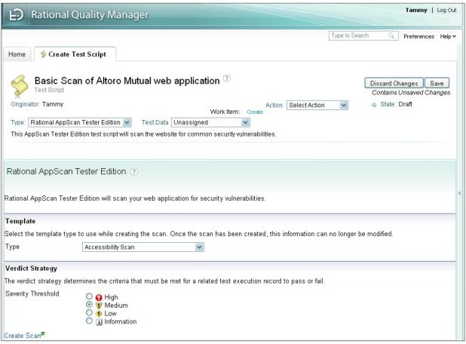
IBM CALMs everyone down
Rational
Quality
Manager
Rational
AppScan
Tester Edition
Templates
Security Levels
Notes:
Collaborative Application Lifecycle Management (although IBM may have originally called it ClearCase or ClearQuest ALM)
Everyone else calls it ALM
Rational may have started the concept and applied it to tools, like they started the Unified Process and Iterative Development. Their flagship product is Rational Team Concert.
Microsoft has VSTS, TFS, PT’s
Parasoft, Coverity, and Atlassian also building ALM portfolios

Slide 7
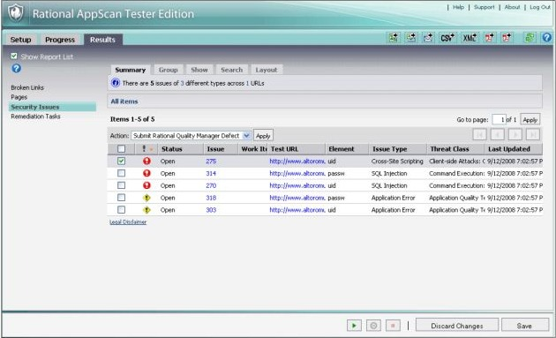
AppScan, Monkey Edition
AppScan
Tester Ed.
Security Issues,
Remediation
Tasks
Submit Rational Quality Manager Defect
Notes:
Pen-testers
IDA Pro -> Undeveloper Studio -> Veracode history
History of web application security scanners e.g. Elza, libwhisker (RFP)

Slide 8
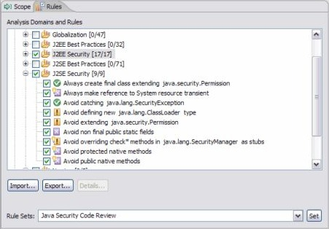
Slowest IDE in the world
Rational
Application Developer for WebSphere Software V7
Code Review (really analyzing source code with static analysis)
J2EE Security Rules
Notes:
A Whole 17 Security Rules is “Impressive”
History of Static Analysis for Security Testing: slint, OpenBSD
MSVC PREfast was a result of the Dildog BO discovery, BO2k, and Code Red I worm
How PREfast works: Abstract Syntax Tree, the Parser, the Data Flow Analysis (DFA)
Rating Systems, Bug Explanations, and Terminology are different between these tools

Slide 9
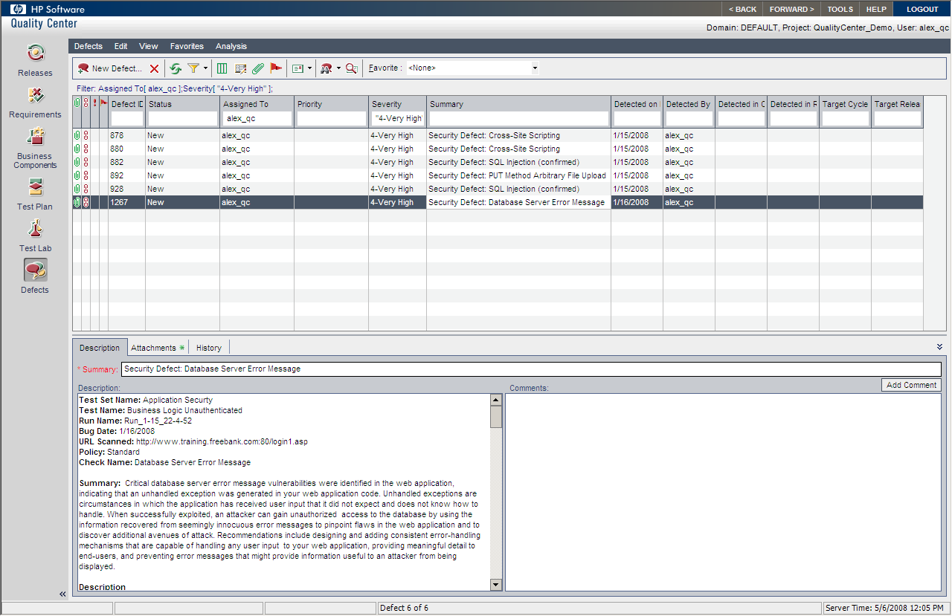
HP also has ALM
HP
Quality
Center
Test Plan,
Test Lab,
Defects
Security Defect Description
Notes:
Capture/Replay vs. Table-driven test cases
QA Tools such as Canoo WebTest, WindMill, Selenium, Watir/Watij/Watin

Slide 10
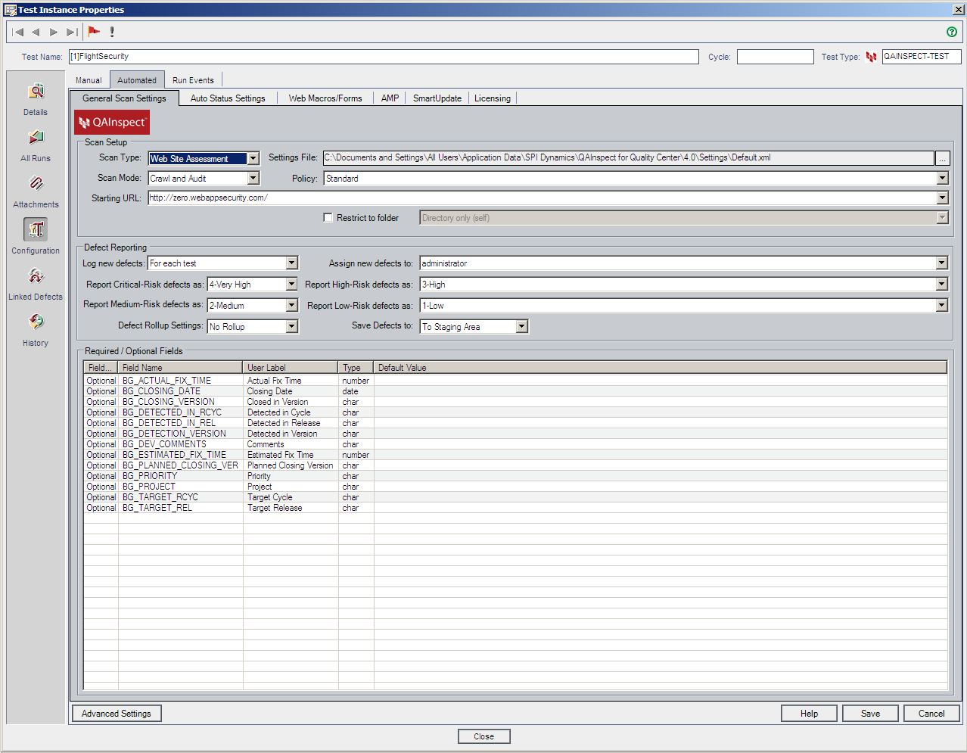
HP also has Monkey scripts
HP
QAInspect V7
AMP Tab
Defect Reporting,
Linked Defects
Required / Optional Fields
Notes:
Robustness Testing
Fuzzing innovations over time, including PROTOS to Codenomicon and SPIKE to Peach Fuzz Framework, Sulley, and similar
QAI uses both QC and AMP

Slide 11
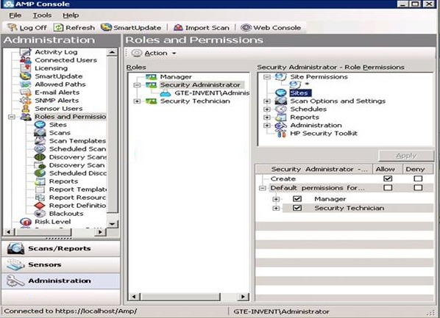
HP adds assessment mgmt
HP AMP Console V8
Sites
Scans
Reports
Sensors
Administer
Notes:
Newest/Latest – AMP Console (Adminsitration -> connect sensors, access control) vs. WebConsole (Operations -> schedule/run tests)
Launch One-Off Tools from AMP Console
History of one-off (defect-based) tools -> Achilles, @Stake WebProxy, OWASP WebScarab
Thousands of these little, often FOSS tools created – but mostly “toys”

Slide 12
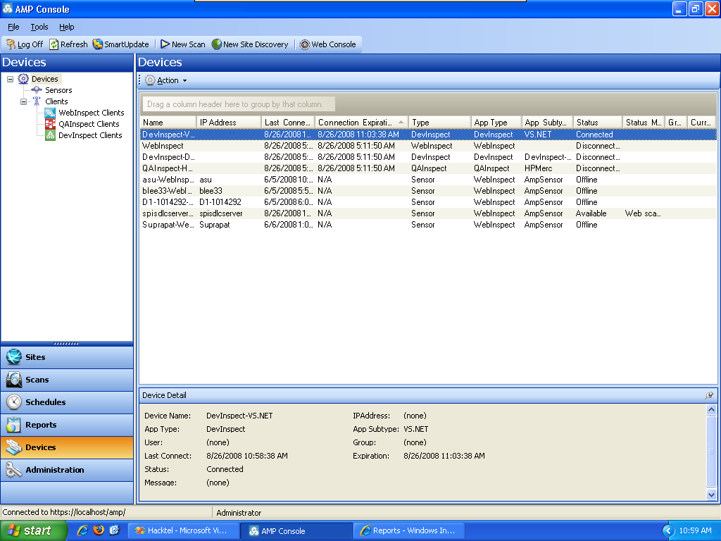
Monkeys & Devs hold hands
HP AMP Console V7
Devices,
Sensors,
Clients
DevInspect
WebInspect
QAInspect
Coming October 2009:
Fortify 360
Notes:
Building teams
DI with AMP in an Outlook-like familiar interface
Cross-Coverage Reports also needed, “Whole Coverage”
JFeature
EMMA
Clover / Clover.NET
Less KLOC means less lines of code, means less money/time/resource investment, especially with, say, Fortify, which charges something like $80k/100KLOC
Eclipse has PMD and Unnecessary Code Detector Plugins
Visual Studio has StyleCop

Slide 13
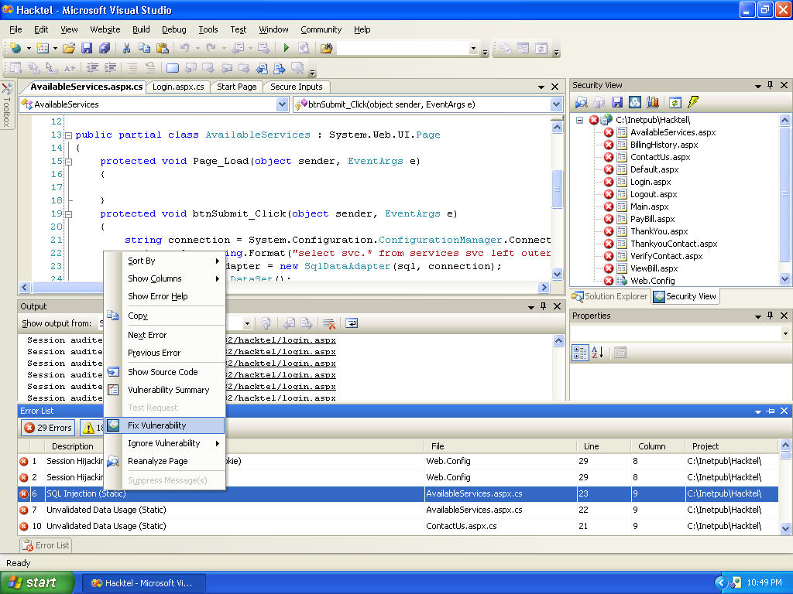
Second slowest IDE
Microsoft Visual Studio 2005, 2008
with HP DevInspect
Secure Inputs, Security View
SecureObjects
Fix Vulnerability
Notes:
Platform vs. Application Vulnerabilities
Secure Objects
MSBuild with CAT.NET or PREfix scans lots of code and creates a backlog

Slide 14
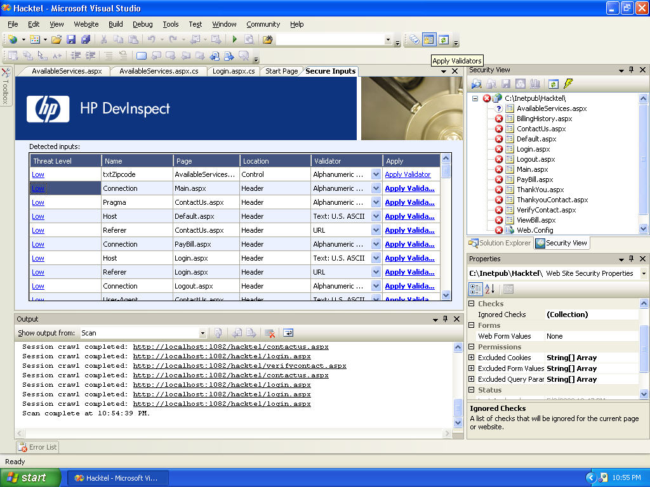
Security Bugfixers exist?
HP DevInspect
Secure Inputs,
Security View
Detected Inputs
Validator
Output
Notes:
Application Security Policy -> Hire a full-timer to concentrate on fixing security bugs
FindBugs
FxCop, FinRad
Security Backlog Management

Slide 15
90%+ False Pos/Neg Rates
Static Analysis Tools Exposition (SATE)
  48k warnings reported: 6 people reviewed a 6k subset over several months, resulting in 1800 findings
  After tuning, tools still had a false-positive error rate of 96%
  After sampling a subset, false-positive rate was still over 70%
Link extraction – wivet.googlecode.com
  No tool achieved 100%, No open-source tool achieved over 50%
Notes:
Tools suck
Can they find real problems?
Can they find problems in legacy code? Modern code? Neither?
E.g. Fortify works on ASP.NET 2.0 and Java Enterprise Struts1&2, but not, say, ASP.NET MVC with LINQ or Java Enterprise Spring with Hibernate or another ORM
How bad it really is

Slide 16
Notoriously don’t work with
Popular frameworks and languages
Annotations, @OP, DI, IoC, ORM
And other words you’ve never heard of
Serialized objects or applets
  Java, Flash remoting, Flex, ViewState, XML|JSON|Javascript|Ajax in the DOM
One language inside (embedded in) another
Notes:
AppSec Tools wouldn’t suck so much if code didn’t suck so much
The tools almost demonstrate / show a root-cause problem if they don’t run properly, crash, loop, and/or find absolutely nothing
AppSec Tools have a hard time keeping up with the constantly changing direction of Application Development

Slide 17
People vs. Tools
Experts
Tools
Experts
Notes:
Exploratory and specialist tools
Process and Methodology around specific defect testing (SME)

Slide 18
Solution
People who verify code by reading it
  Source Insight
  Notepad++
  Follow ASVS, map tools to activities
Desire to learn
  Training or community should follow
Governance and appsec policies
Notes:
Syntax Highlighting
Running through controls in a week e.g. 15 minutes per verification control

Slide 19
How I know this
http://isbn.nu/1933952199/ (Advanced Software Testing)
http://isbn.nu/143021080X/ (Pro Visual Studio Team System Application Lifecycle Management)
http://isbn.nu/0738431974/ (Collaborative Application Lifecycle Management with IBM Rational)
https://buildsecurityin.us-cert.gov/daisy/bsi/articles/best-practices/code/212-BSI.html
http://www.ivarjacobson.com/products/essup.cfm
http://msdn.microsoft.com/en-us/teamsystem/aa718795.aspx
http://vstsscrum.codeplex.com
http://scrumforteamsystem.com
http://msdn.microsoft.com/en-us/security/dd670265.aspx
http://news.cnet.com/8301-13505_3-10218777-16.html
http://en.wikipedia.org/wiki/Rational_Application_Developer#Criticisms
http://www.isecpartners.com/files/SD%20Best%20Practices%20-%20Code%20Scanning%20Case%20Studies.pdf
http://www.cigital.com/justiceleague/2009/03/30/maturity-models-vs-top-10-lists/
http://samate.nist.gov/index.php/SATE.html
http://deblaze-tool.appspot.com/
http://www.matasano.com/log/1739/ruby-for-pentesters-a-viewstate-deserializer/
http://weblogs.java.net/blog/inder/archive/2007/01/fortifying_web.html
http://www.owasp.org/index.php/Man_vs._Code
http://www.greebo.net/2009/06/18/using-asvs-for-real/

Slide 20
Extra Credit: WAFs
WAFs are Monkey scripts cleverly marketed as network-based firewalls
WAFs can be helpful for improving findings in the lab
  Microsoft AntiXSS SRE config generator
  GDS Security SPF and IIS7 features
  Mod-security can find XSS on the outbound, R.Barnett BlackHat DC 09

